Slide 1
GCP Experience

Slide 2
Some principles
If we want to have an efficient and cost effective process to run applications
Need a good development environment
Need a good infrastructure
Resiliency
Updates with no downtime
Canary, Blue/Green deployments
Not to mention a DevOps culture in place

Slide 3
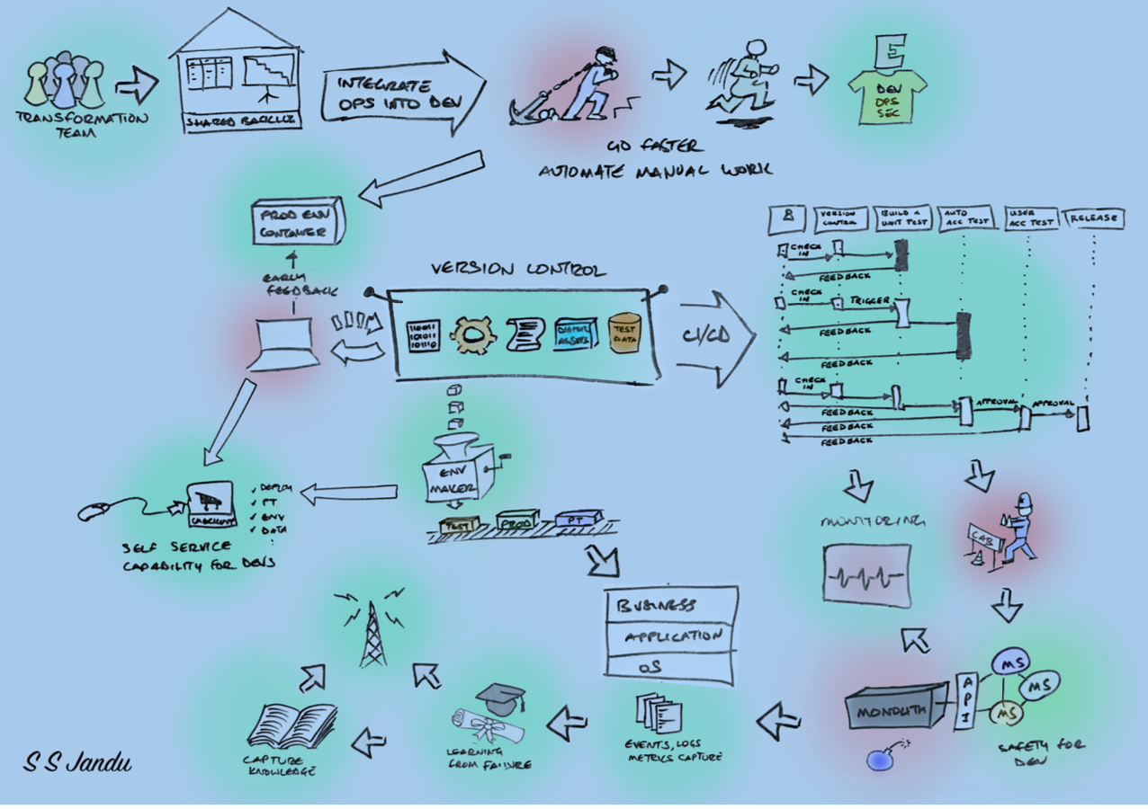
The “desired” model

Slide 4
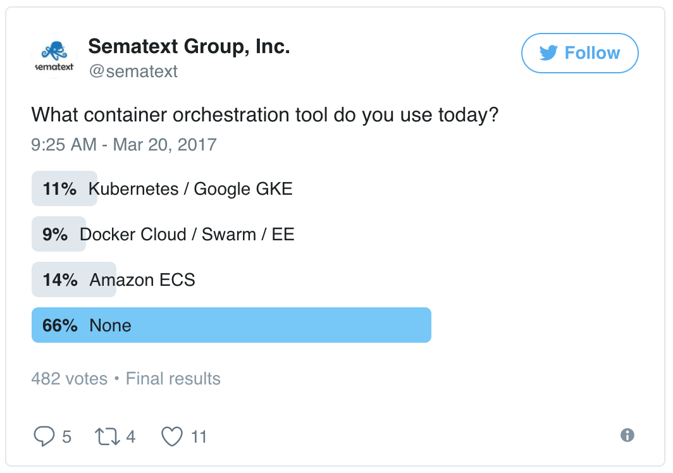
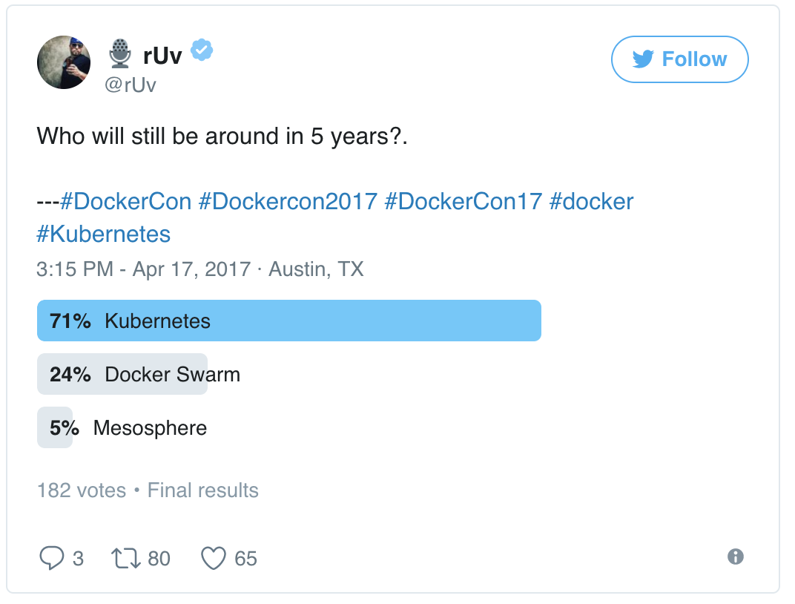
Trends on orchestration
https://sematext.com/blog/2017/04/24/docker-orchestration-poll-kubernetes-swarm-amazon-ecs/

Slide 5
My GCP journey
Started as a “simple” user – manual onboarding
Got permission to create services (Basilica)
Could not use the services created: no GUI available
Work with Ravi to get Spark to run
No HDFS local or remote, all in memory
Could not get results or logs – no debugging capabilities
Cannot delete/update services
Created Kafka service (that was used later on)
Spark and Kafka are the OpeSource versions, no authentication, no security

Slide 6
My GCP journey
Experiment with container
No or very limited access to DC-OS
Access via gcp-api
Latest version made available gcp-cli (more on this later)
How to build an image
AIM-PM tool (requested access and installed tool in windows system)
Not user friendly at all: Jitu provided me wit a working script that I adapted
Operation: after code developed, run scripts, check on another site to check for build status
Could not get ”pip” to run (module manager for python)
Worked with Mike … (AIM)
Worked with Jeff who gave the “recipe” that worked
Worked with Jeff to resolve images not showing in QuayGCP GUI that had multipage build
Extremely difficult to develop anything of substance without proper access to a DEV environment
Got access to a lab machine where docker machine was installed
Transfer files via “python SimpleHTTPServer”
Back on GCP, was given permission to access logs (stdio, errors)

Slide 7
GCP: image build process
Dockerfile
<Code>
Script:
6 steps
Quay: Registry
Dockerfile
<Code>
Docker build
Docker push (optional)
GUI
Status
BuildLogs

Slide 8
GCP: container run process
Swagger
Postman
Post
Get
GUI
Get Logs/Output
Marathon
json
Docker run
Quay: Registry

Slide 9
Run containers
Experiment with container
No or very limited access to DC-OS API
Access via gcp-api
Latest version provides gcp-cli (more on this later)
Could deploy image and run image with curl or postman
A new image is created for changes in the code or Dockerfile
This new image needs to be reflected in marathon.json
Difficult to develop anything of substance without proper access to a DEV environment
Got access to a lab machine where docker machine was installed
Transfer files via “python SimpleHTTPServer”
Back on GCP, was given permission to access logs (stdio, errors)

Slide 10
Conclusion
Currently
Need a better development experience
Need to have better clarity from JPMIS regarding marketplace
A good candidate for run vendor/external images
Need a good infrastructure

